Slide 1
Weak Lensing
Tom Kitching
_{Henk Hoekstra, Karim Benabed}

Slide 2
A Review of Weak Lensing
Theory
Why do we measure?
From General Relativity
Measurement
What do we measure?
Requirements
How accurately do we need to measure?

Slide 3
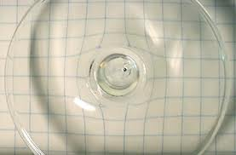
Gravitational Lensing
You can tell what a lens is made of by the distortion it creates

Slide 4
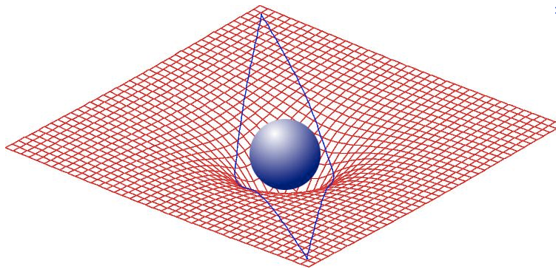
Gravitational Lensing
Einstein: Mass bends spacetime, and distorts the path that light rays take

Slide 5
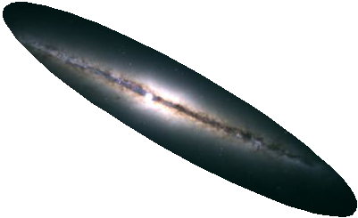
Gravitational Lensing
Einstein: Mass bends spacetime, and distorts the path that light rays take

Slide 6
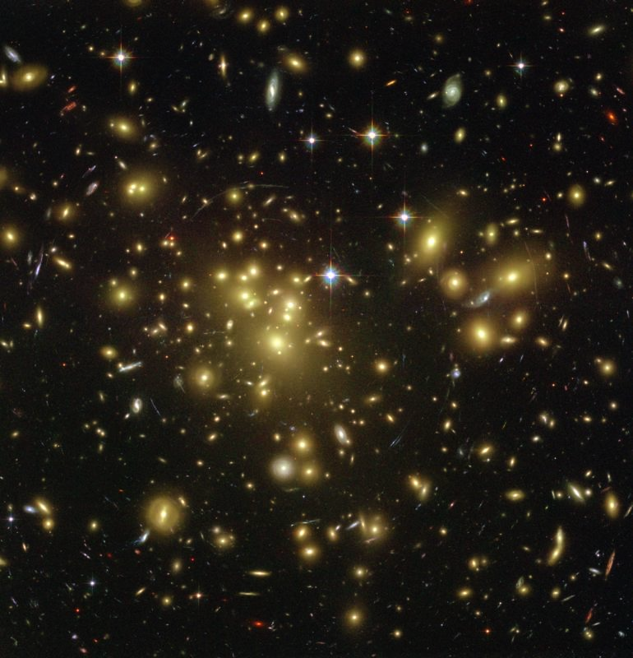
Kappa > 1
Strong Lensing
Multiple Images
See Massimo Meneghetti’s Presentation
z
© NASA

Slide 7
‘Weak’ Lensing
Every galaxy experiences some lensing
Caused by matter along the line of sight

Slide 8
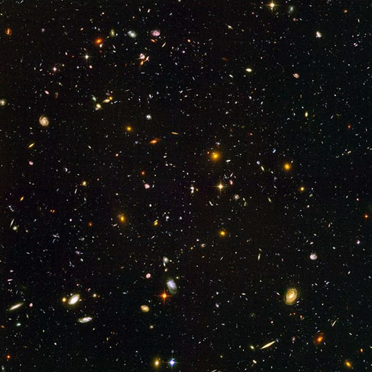
Kappa<< 1
Weak Lensing
Local Distortion
z
© NASA

Slide 9
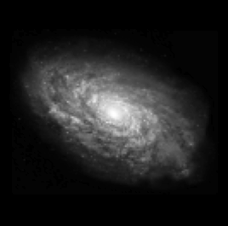
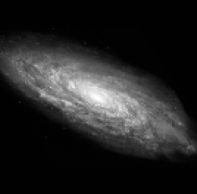
The weak distortion is simply a (very small) change in ellipticity of a galaxy
Dark Matter

Slide 10

The weak distortion is simply a change in ellipticity of a galaxy

Slide 11
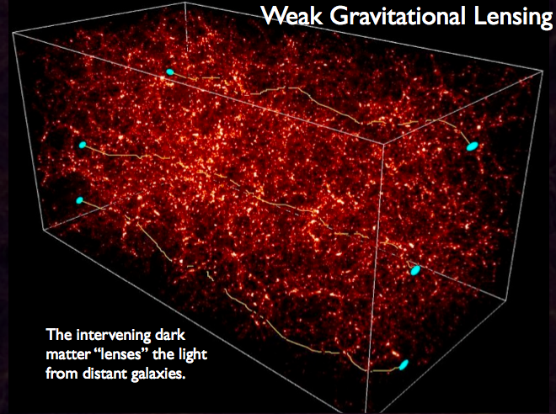

Slide 12
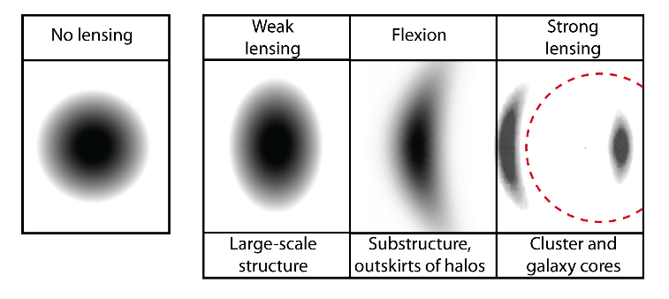
What is weak lensing?
strong vs. weak lensing

Slide 13
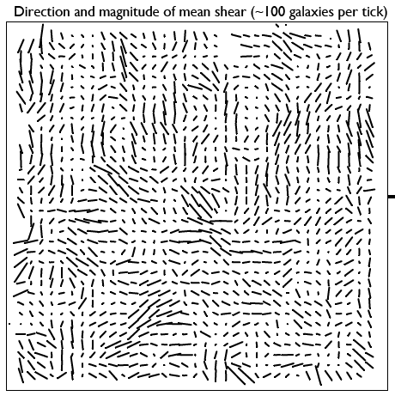

Slide 14
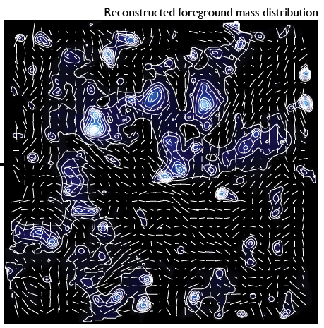

Slide 15
Same but with more technical details

Slide 16
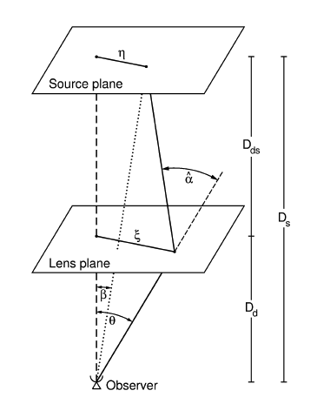
What is Gravitational Lensing?
Propagating photons follow geodesics in space
The geodesics are distorted from straight lines by the presence of massive objects
Even in Newtonian Gravity photons would be deflected from straight line path
Notes:
Basic idea behind gravitational lensing

Slide 17
Geometry
The Born Approximation
Notes:
The geometry of lensing

Slide 18
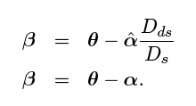
The Lens Equation
Lens equation and define the terms
Simple Geometry
Relates True Position
to Observed Position
Notes:
An expression of that geometry

Slide 19
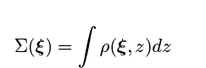
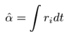
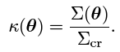
Relates True Position to
Observed Position
Thin Sheet Born Approximation :
Text
Kappa > 1 =
Strong Lensing
Kappa << 1 =
Weak Lensing

Slide 20
Deflection Angle from GR
Want to know what the integrated deflection angle is
Next slides has a lot of maths…. So will quickly skip over it!

Slide 21
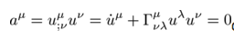
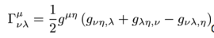
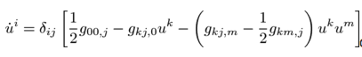
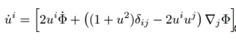
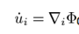
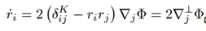
From GR
Metric in the Weak Field Limit
Newtonian Potential
GR Equation of Motion
Γ related to metric g
Set time-changes in metric to be small g_{i0}=0. Spatial Part:
Sub metric :
Newtonian Limit u_{i}<<c :
Relativistic Limit u_{i}~r_{i}c :

Slide 22
Take home message
The amount of deflection depends on the derivative of the local gravitational potential

Slide 23
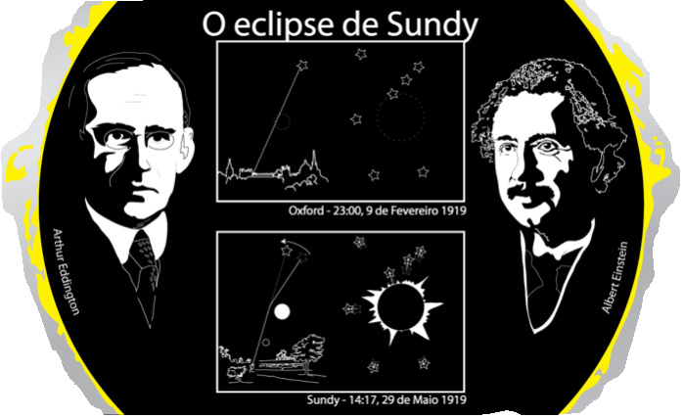
GR-Newton Factor of 2 Confirmed in 1919
Euclid launches (hopefully!) 100 years later!
© R. Massey 2010

Slide 24
Kappa<< 1
Weak Lensing
Local Distortion
z
© NASA

Slide 25
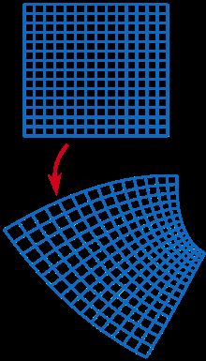
The Distortion Matrix
Go back to the lens equation
Every point is mapped to a new point via a shear mapping

Slide 26
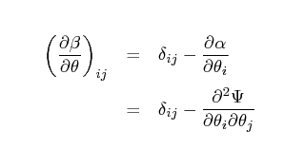
The Distortion Matrix
Define a lensing potential ψ
Projected Newtonian potential - Born approximation (linear transform)
Derivative of the lens equation
Describes how unlensed point maps to lensed point
ψ=0 implies no mass and no lensing

Slide 27
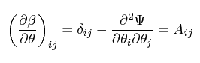
The Distortion Matrix
Define the Distortion Matrix (Jacobian) as
Second derivatives of the lensing potential
ψ₁₁, ψ₂₂, ψ₂₁, ψ₁₂

Slide 28
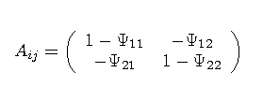
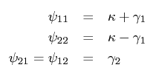
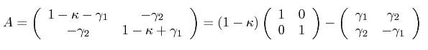
Shear and Convergence
Closer look at the Distortion matrix
Decompose into a trace and traceless part
Define

Slide 29
Shear and Covergence
What shape of distortion does this imply?

Slide 30
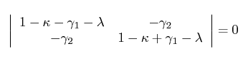
Disortion is Elliptical
For a general set of source positions X write the eigen equation
AX=λX
(A-λ)X=0
Characteristic equation : |A-λ1|=0
λ are the eigenvalues

Slide 31
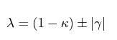
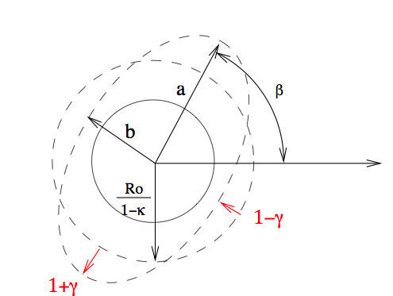
Distortion is Elliptical
Solving the determinant

Slide 32
Distortion is elliptical
Size change
Ellipticity change
γ₁
γ₂

Slide 33
Recap
Lensing equation
Local conformal mapping
General Relativity relates this to the gravitational potential
Distortion matrix implies that distortion is elliptical : shear and convergence
Simple formalise that relates the shear and convergence (observable) to the underlying gravitational potential

Slide 34
Measurement

Slide 35
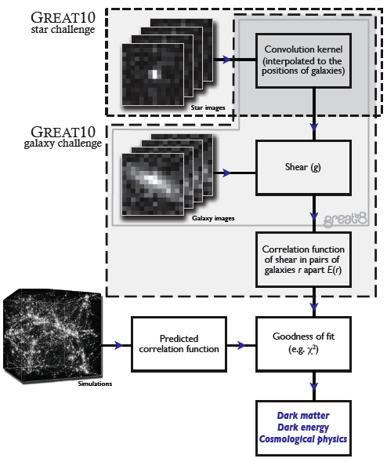

Slide 36
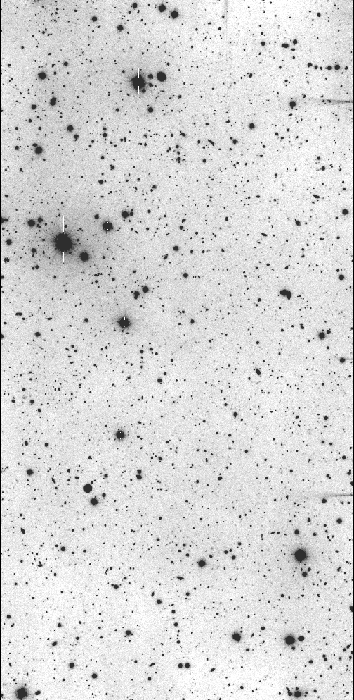
Typical galaxy
used for cosmic
shear analysis
Typical star
Used for finding
Convolution kernel

Slide 37
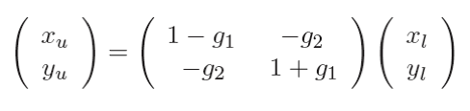
Cosmic Lensing
g_{i}~0.2
Real data:
g_{i}~0.03
37/19
Notes:
37

Slide 38
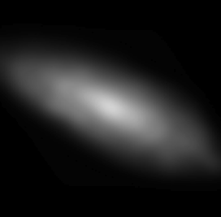
Atmosphere and Telescope
Convolution with kernel
Real data: Kernel size ~ Galaxy size
38/19
Notes:
38

Slide 39
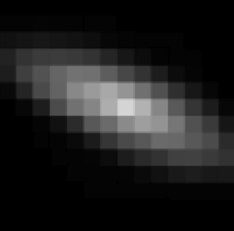
Pixelisation
Sum light in each square
Real data: Pixel size ~ Kernel size /2
39/19
Notes:
39

Slide 40
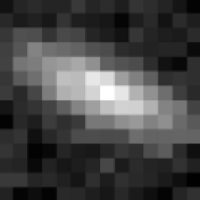
Noise
Mostly Poisson. Some Gaussian and bad pixels.
Uncertainty on total light ~ 5 per cent
40/19
Notes:
40

Slide 41
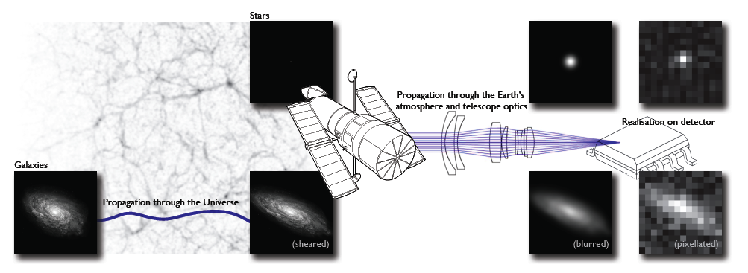
Need to measure shear to 10⁻³
Large Scale Structure imprints an ADDITIONAL ELLIPTICTY called SHEAR

Slide 42
What is ellipticity
Specified by 3 numbers
Semi-Major axis
Semi-Minor
Angle
Many different
equations for an ellipse use
different parameterizations
and coordinate systems
a=Semi-Major Axis
ϑ
b=Semi-Minor Axis
Best to think of an ellipse as a compression/stretching of
the axes, followed by a rotation

Slide 43
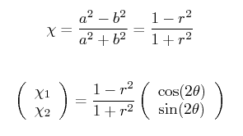
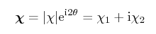
X₁
X₂
Create a single (complex) number “ellipticity”
Include orientation
r=1 means?
Why 2, what does this mean?

Slide 44
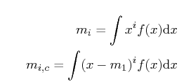
How to measure ellipticity?
Consider moments of a 1D distribution
0th Moment = ?
1st Moment = ?
2nd Moment = ?

Slide 45
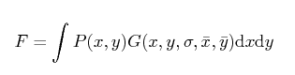
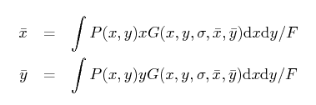
Moments of a 2D Function
Include a weight G
0th Moment (flux)
1st Moments
Mean x
Mean y

Slide 46
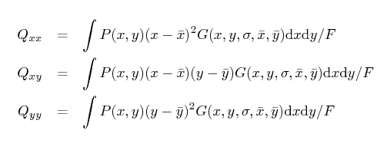
2nd Order Moments in 2D
Three 2nd order moments
Recall that ellipticity needs 3 numbers so we suspect they are related

Slide 47
How are Q related to ellipticity?
acosϑ
Note:
Q are variances (so squared quantities)
Homework: prove the Q_{xy}
a
asinϑ
ϑ
ϑ
b
bcosϑ
Q_{xx}=F(a²cos²ϑ+b²sin²ϑ)
Q_{yy}=F(a²sin²ϑ+b²cos²ϑ)
Q_{xy}=F(a²-b²)sinϑcosϑ
bsinϑ
Notes:
Maths on the board

Slide 48
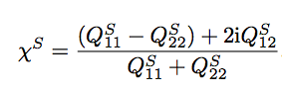
How are Q related to ellipticity?
Q_{xx}=F(a²cos²ϑ+b²sin²ϑ)
Q_{yy}=F(a²sin²ϑ+b²cos²ϑ)
Q_{xy}=F(a²-b²)sinϑcosϑ
Take combinations:
Q_{xx}+Q_{yy}=F(a²+b²)
Q_{xx}-Q_{yy} =F(a²-b²)cos2ϑ
2Q_{xy} =F(a²-b²)sin2ϑ
Notes:
Note that the subscript S has been used….

Slide 49
Intrinsic Ellipticity
Have introduced here the notion that the sources themselves are already elliptical
“Shear” is an additional ellipticity imprinted by lensing
How to related observed ellipticity to shear?
g₁
g₂

Slide 50
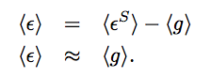
The Weak Lensing Assumption
When we average over (enough) galaxies in the universe the intrinsic ellipticity is randomly orientated such that
This is an approximate expression
KEY WEAK LENSING RESULT
RELATES
OBSERVABLE (MOMENTS) to
PHYSICS (LENS EQUATION) and SHEAR

Slide 51
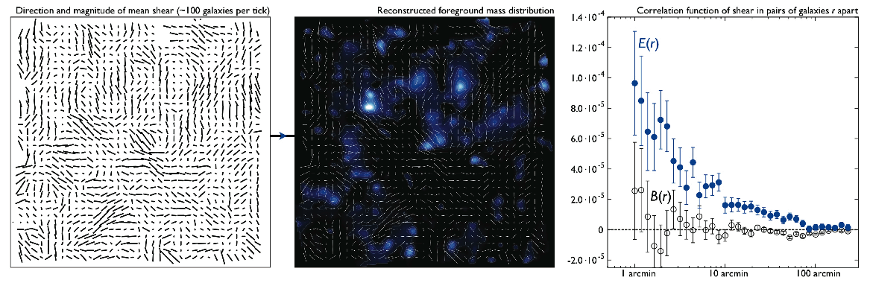
When averaged over sufficient area the shear field has a mean of zero
Use 2 point correlation function or power spectra which contains cosmological information

Slide 52
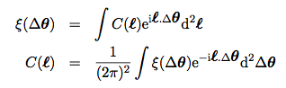
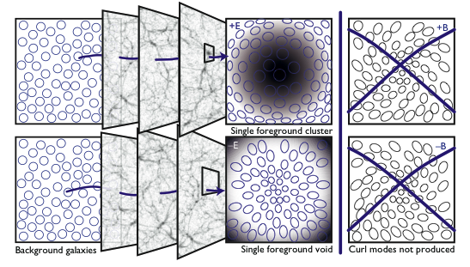
Correlation function measures the tendency for galaxies at a chosen separation to have pre- ferred shape alignment

Slide 53



“Tomography” i and j refer to redshift bin pairs
Generate 2D shear correlation in redshift bins
Can “auto” correlate in a bin
Or “cross” correlate between bin pairs
z

Slide 54
How well do we need to measure shapes?

Slide 55
How well do we need to measure shapes?
If there is a mis-match between the estimated/measured shape and the true shape then results on cosmology will be biased (incorrect)
STEP parameterisation
g^{true}=(1+m)g^{measured}+c
Can also propagate this through to power spectra
What is M?
What is A?

Slide 56


How does the PSF affect the moments?
Massey, Hoekstra, Kitching et al. 2012
Propagation through the moments equations
For convolutive effects

Slide 57


Can expand as a Taylor series, and substitute derivative
Can read of these and match to STEP
See absolute values and uncertainty in the values δ
Weak lensing needs SMALL and WELL KNOWN PSF
Depends quadratically on the size of the PSF

Slide 58


Can propagate through to power spectrum (dark energy requirements)
Easier from Space
Size of PSF
Knowledge (variance)

Slide 59

w₀
w_{a}
Power
Spectrum
l²C(l)
Monte Carlo
M and A
l mode

Slide 60
For Euclid to measure unbiased dark energy parameters
m < 2x10⁻³
σ(c) < 1.3 x 10⁻⁶
These calculations form the basis of the SciRD requirement and the science objectives predictions in the Red Book

Slide 61
A Review of Weak Lensing
Theory
Why do we measure?
From General Relativity
Measurement
What do we measure?
Requirements
How accurately do we need to measure?

